Slide 1
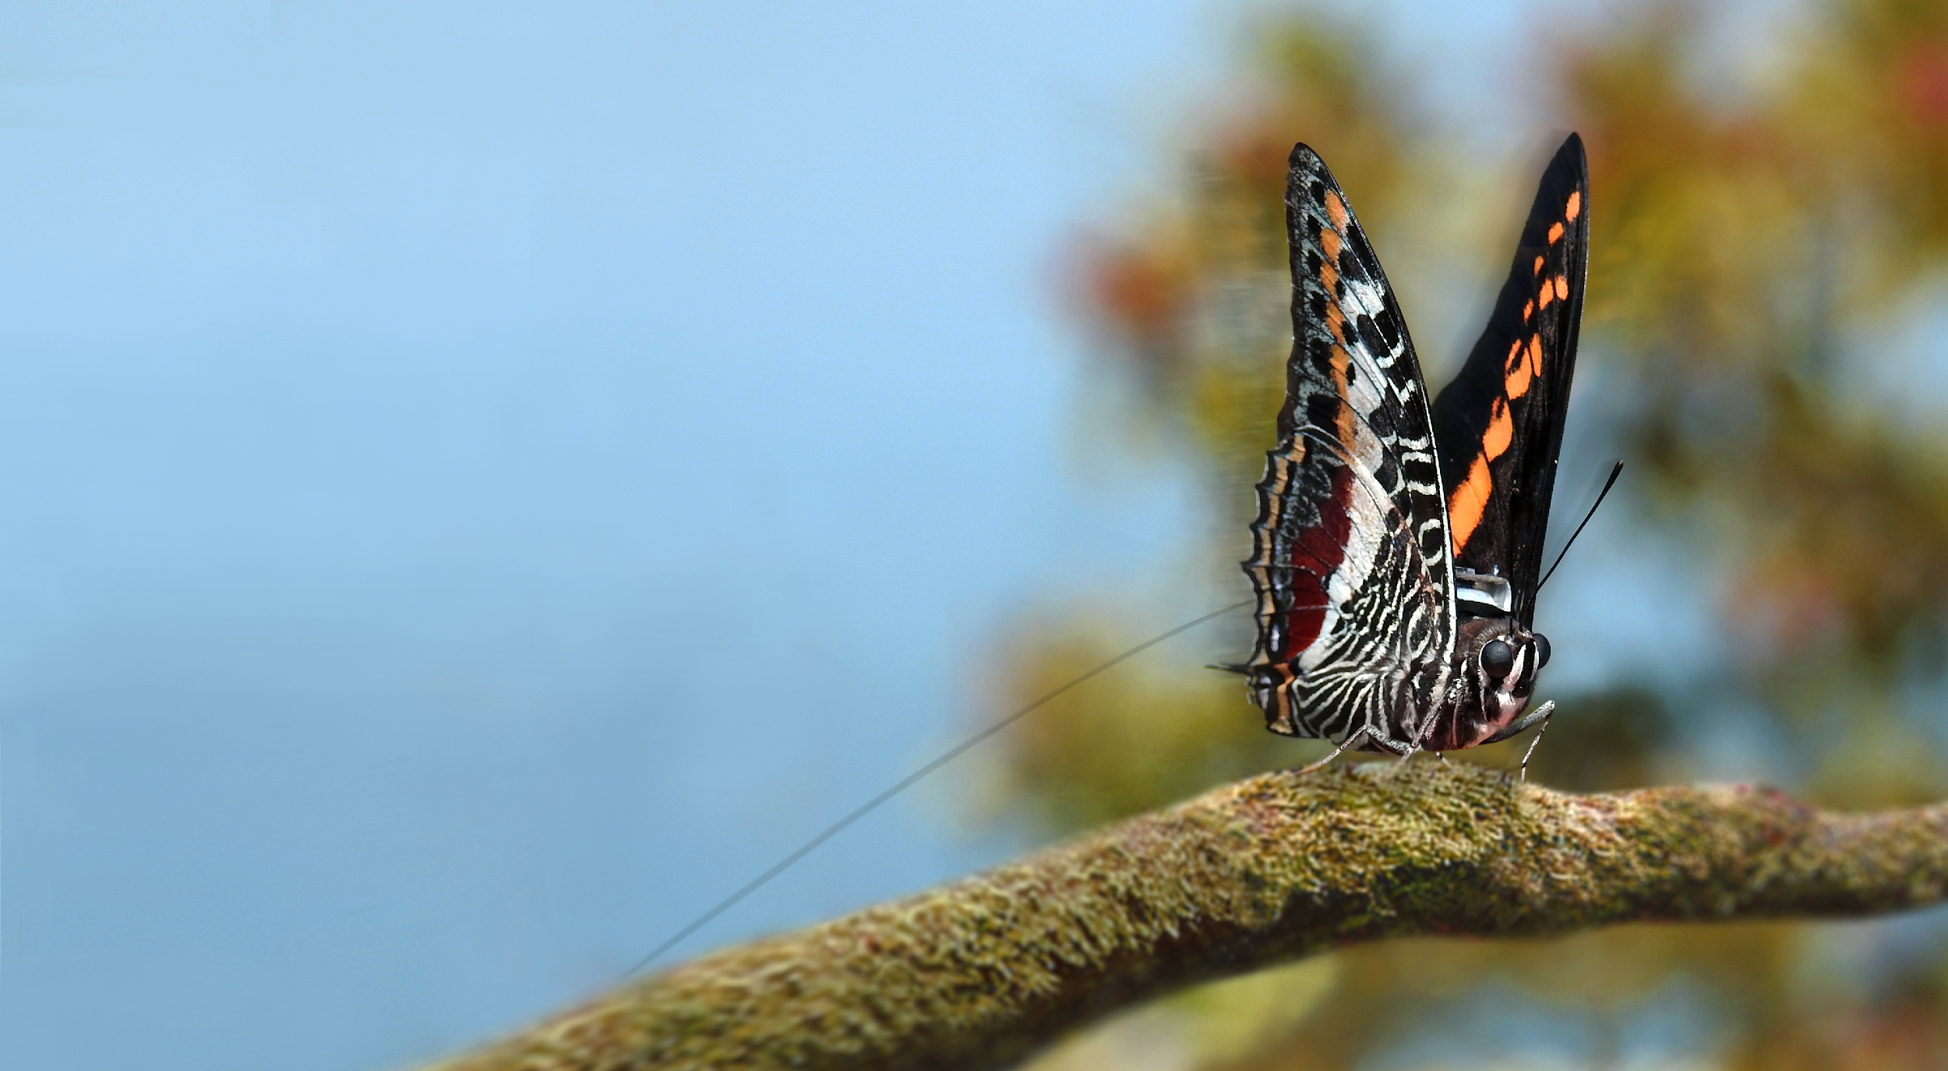
New Method in Small Animal Tracking by Automated Radiotelemetry System (ARS)

Slide 2
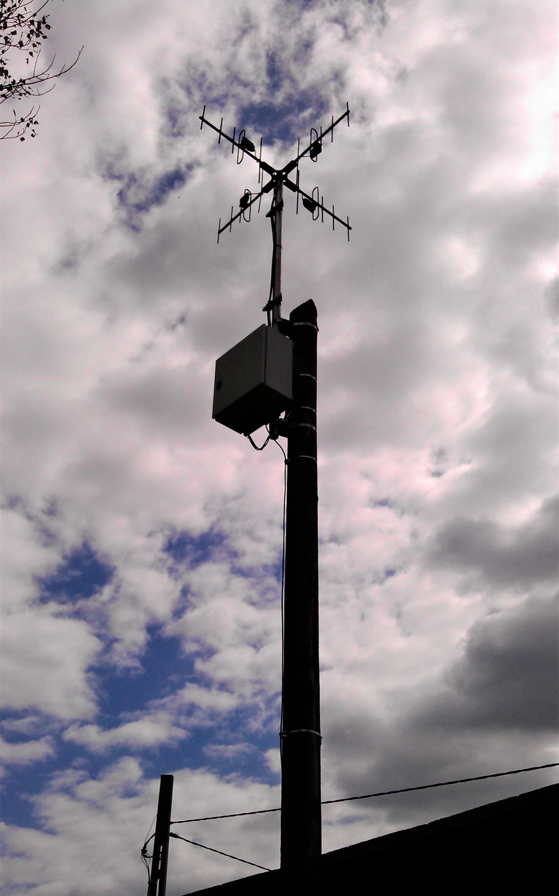
Automatized Radiotelemetry System
State of the art fully automatized system
Based on a newly developed digital radio system (not using beeper-type transmitters)
434 MHz harmonized band
RSS (received signal strength) based positioning is a relatively new area of research, and there are very few practical applications so far
Highly effective method for small animal tracking, monitoring and observation

Slide 3
Why is it such a good solution?
No data loss, - vs traditional, GNSS and radio scanning logger systems
Minimal energy consumption – high efficiency thanks to no data loss and digital transmitters
Simultaneous reception of signals unlike traditional manual tracking and automated scanning method
Significantly higher range compared to traditional beeper type transmitters

Slide 4
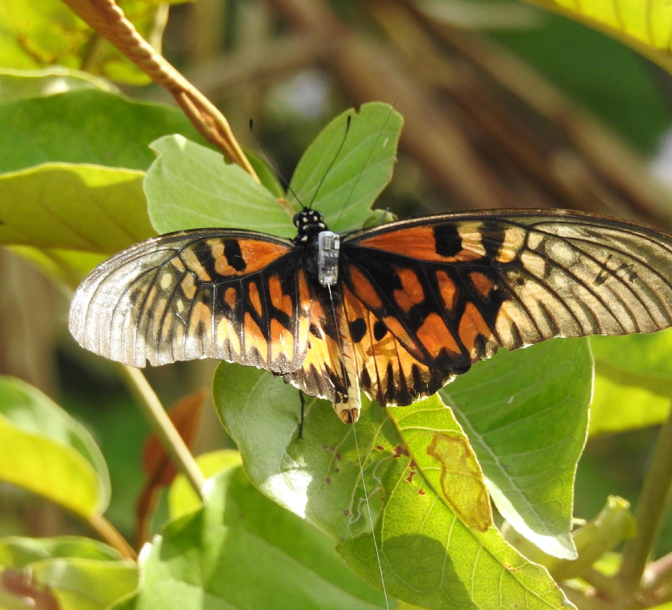
Transmitters
They can be tiny and very light
Go down to 0,16 g
Programmable

Slide 5
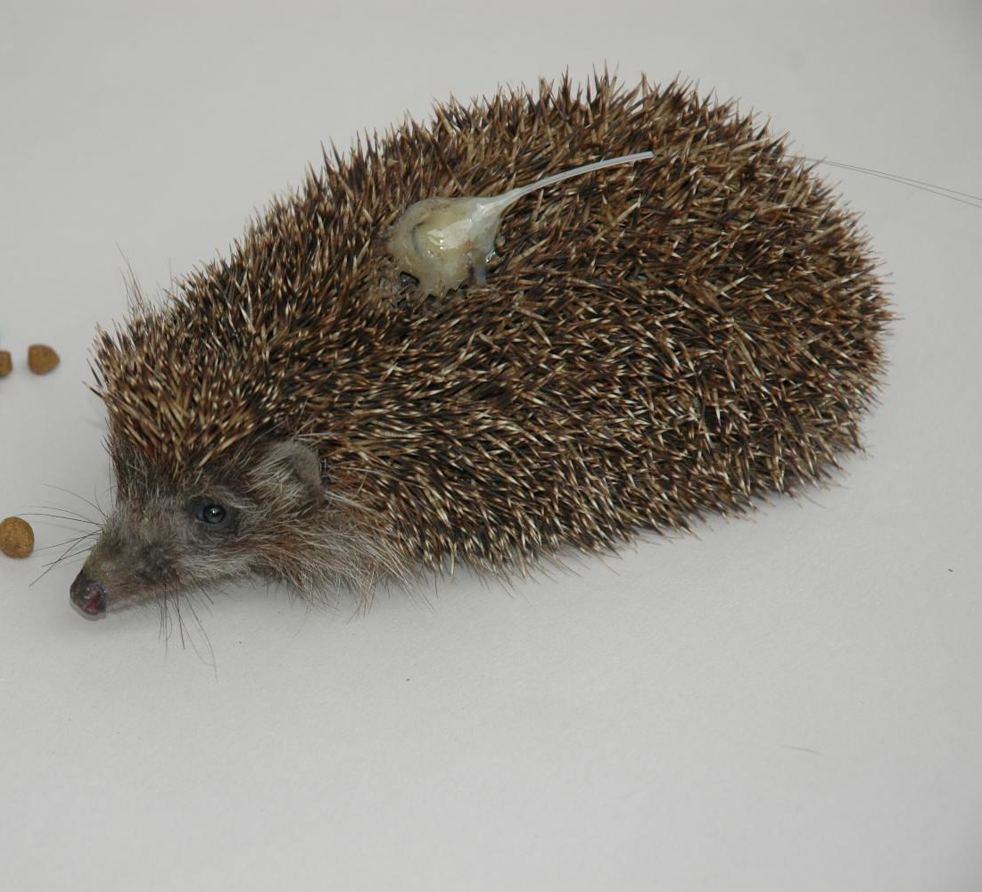
Can be fixed in several ways: glue, harness, etc.

Slide 6
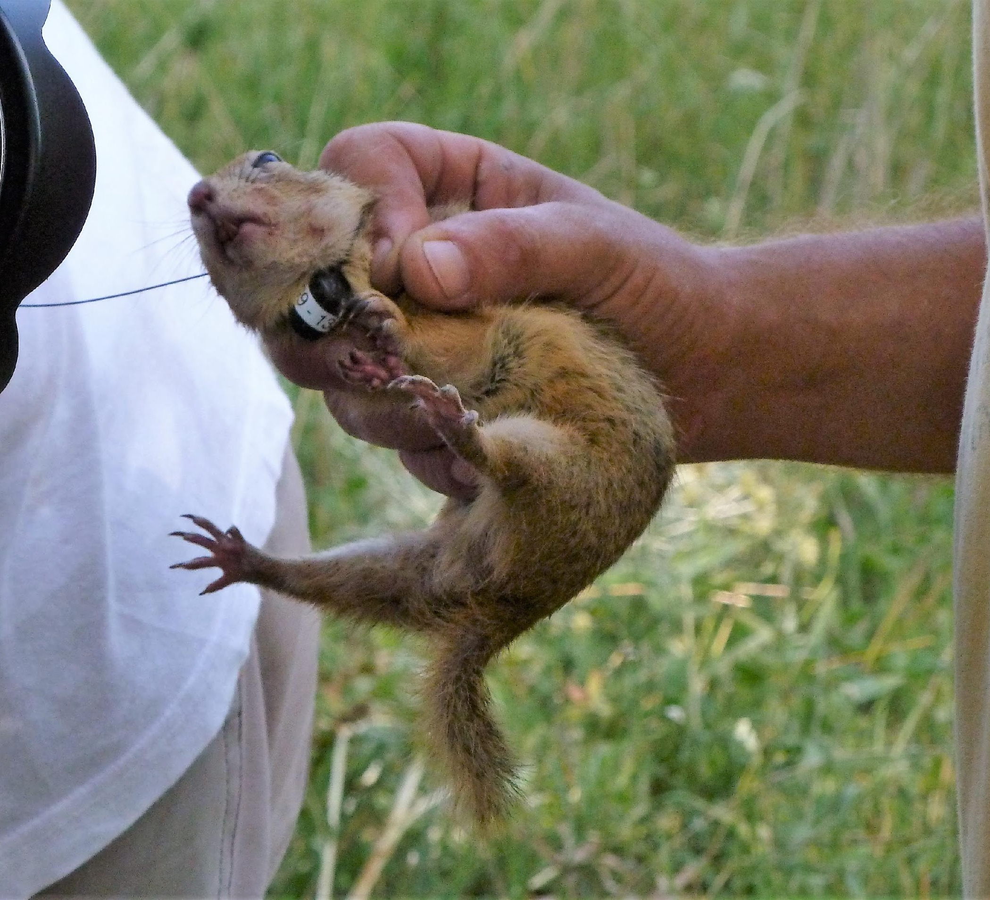
High output power and long operating time despite its small size
Multi-channel reception on a single frequency are made possible by digital transmitters

Slide 7
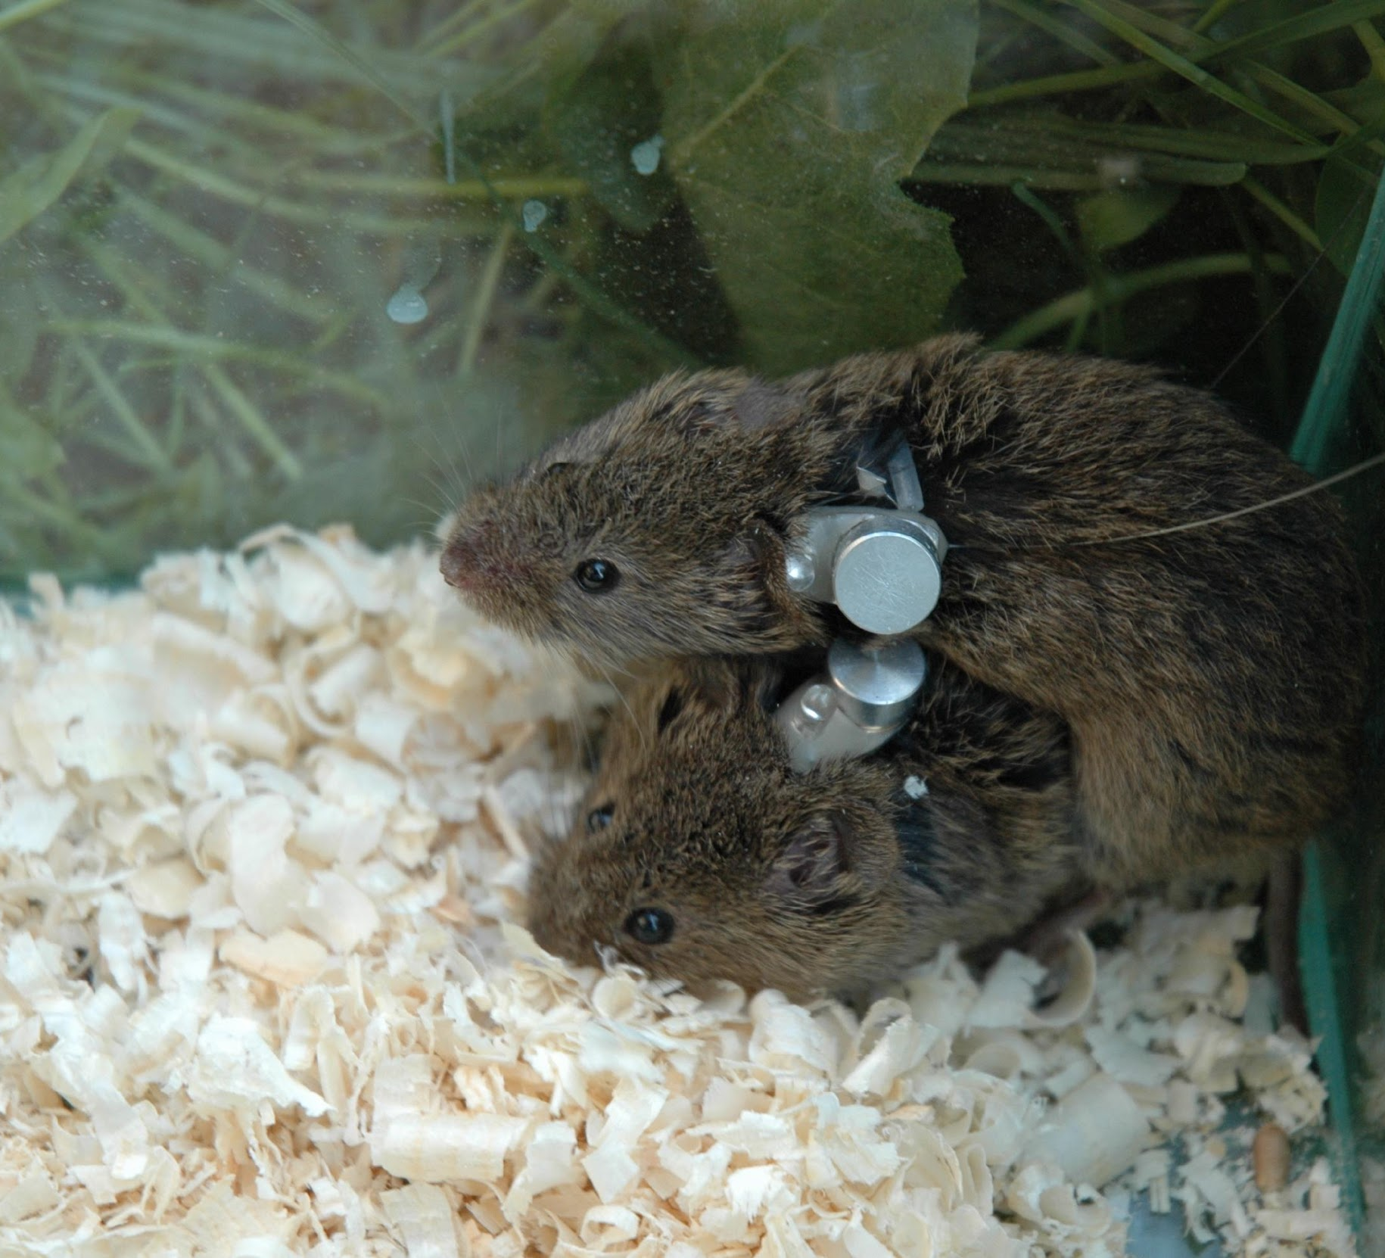
Various type of data can be transmitted integrated into the radio signal
MEMS Special sensors:
thermometer
humidity sensor,
accelerometer,
light sensor,
magnetic sensor,
etc.

Slide 8
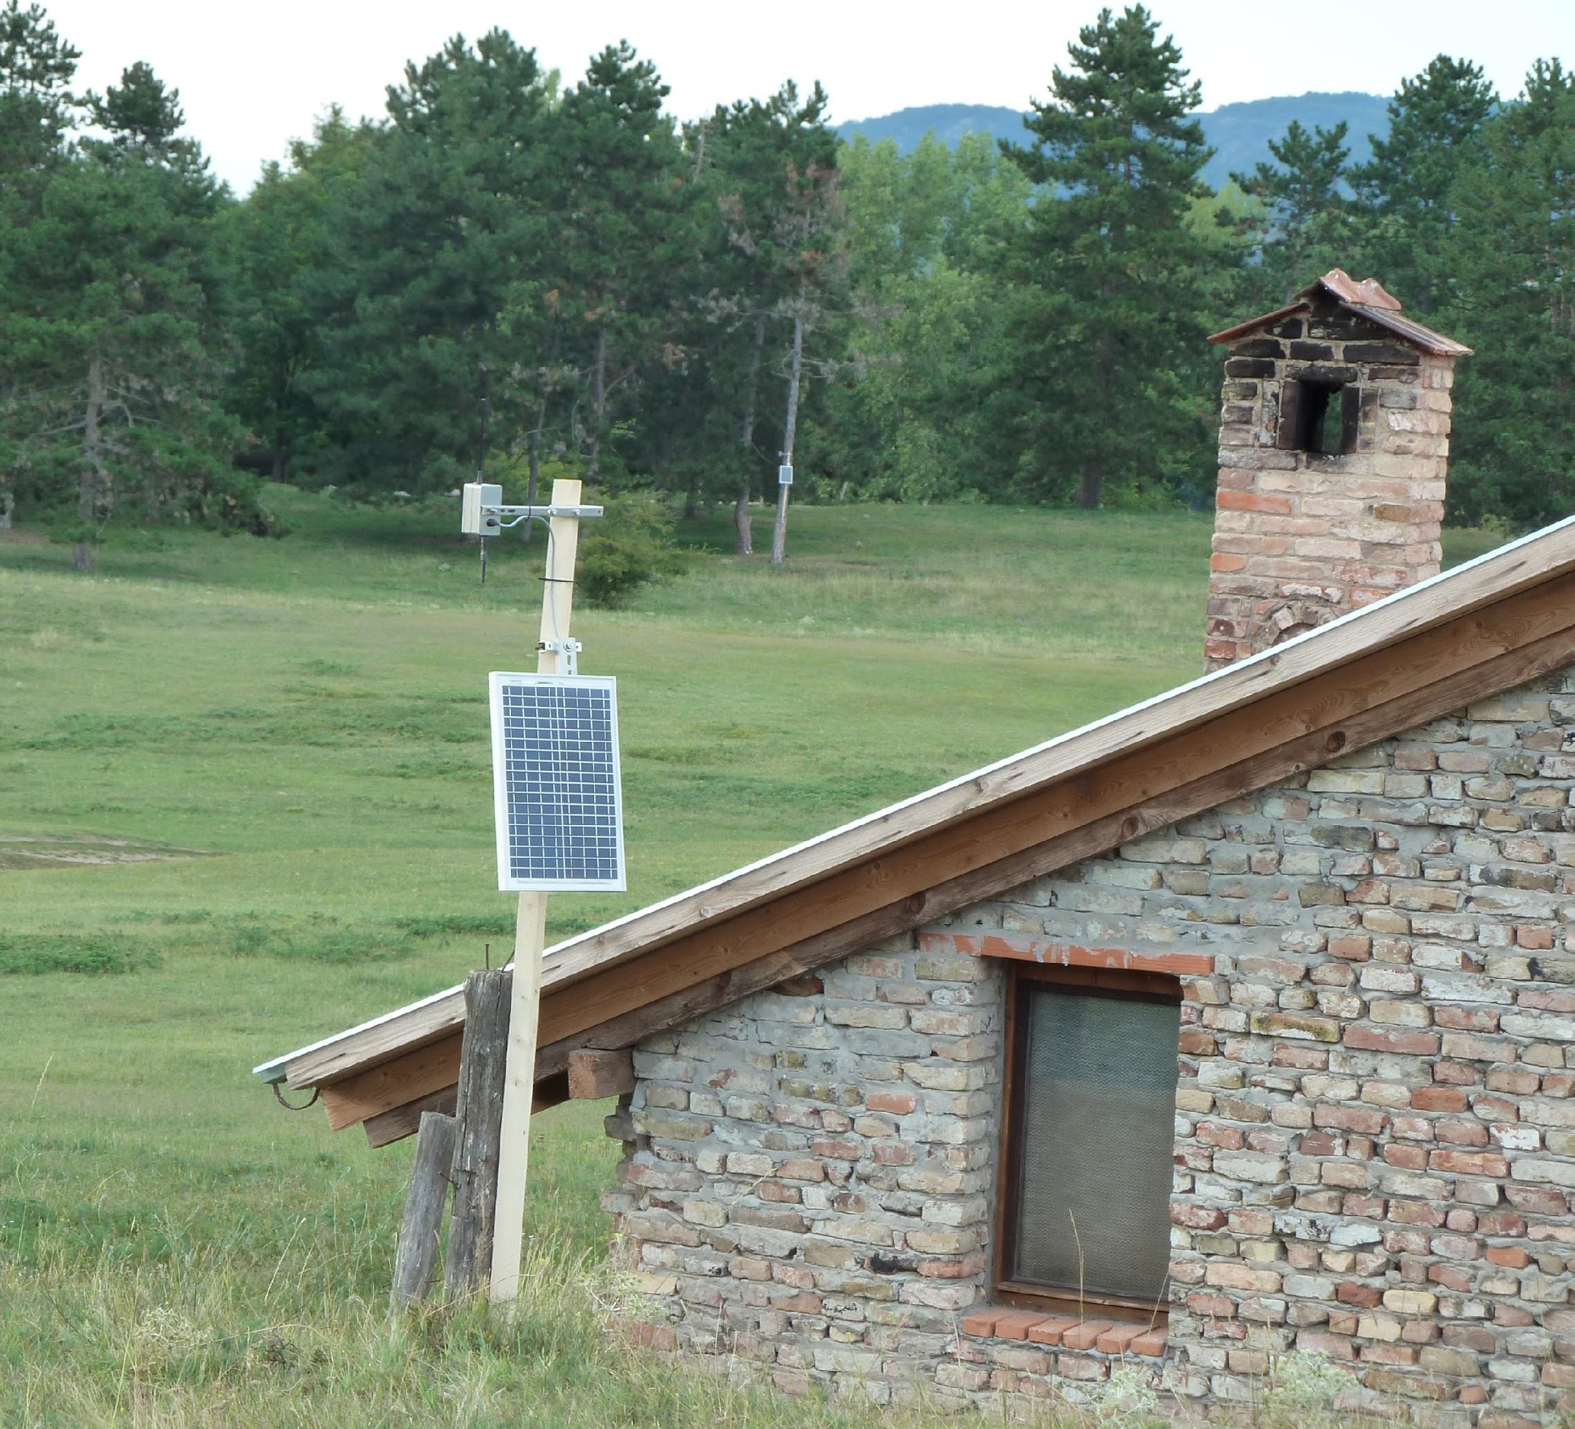
Receiver Unit
Receives and decodes signals from the animals
Sends received data to the central unit
Power supply possibilities:
battery,
solar cell
network

Slide 9
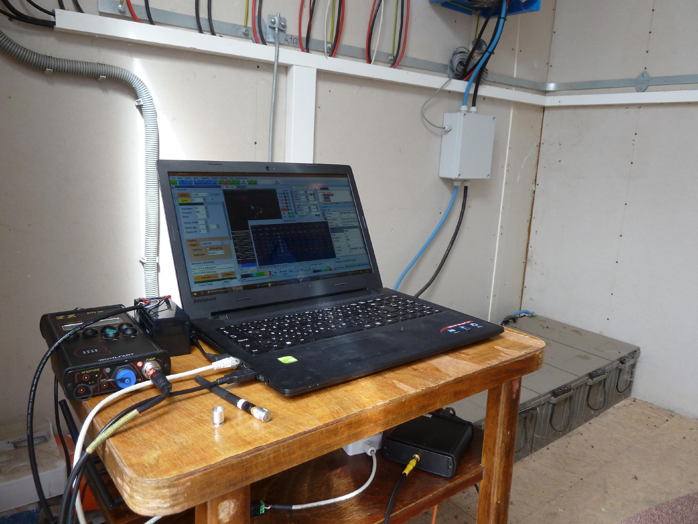
Central Unit
Receives preprocessed data from the receiver units
Logs and displays data with a special data logger and visualisation software
Remote controlled via internet
Can be operated also by a solar unit (ca. 200W)
Can be placed rather far from the observation area (even 10-20 km – depending on the topography and other environmental circumstances)

Slide 10
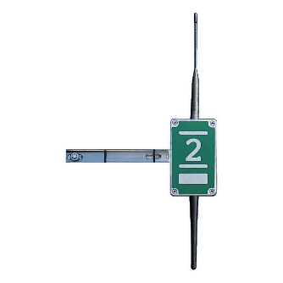
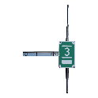
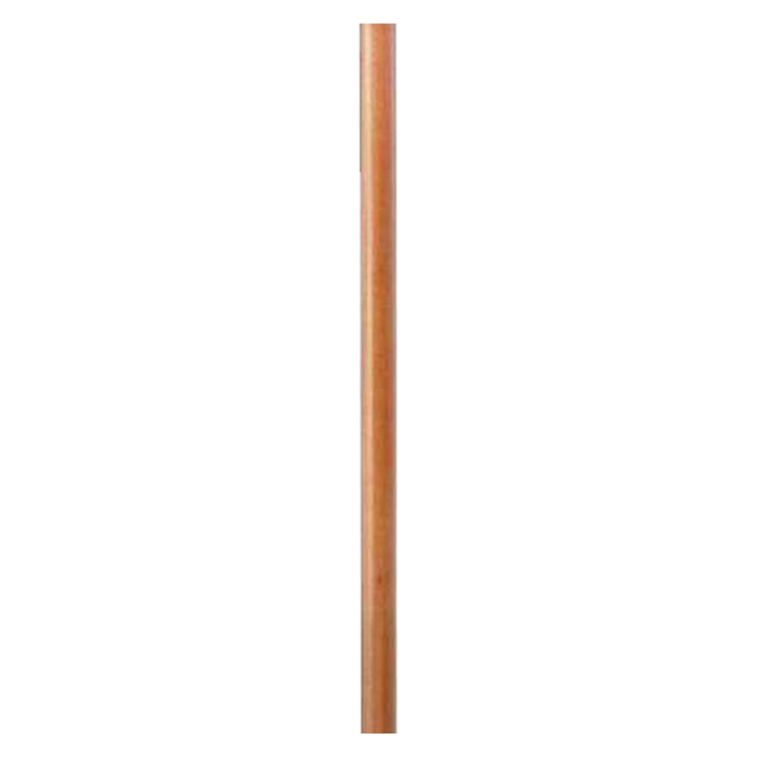
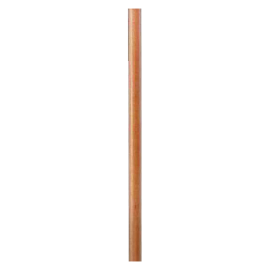
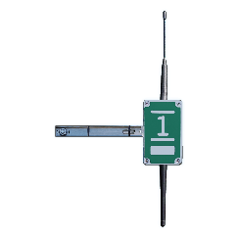
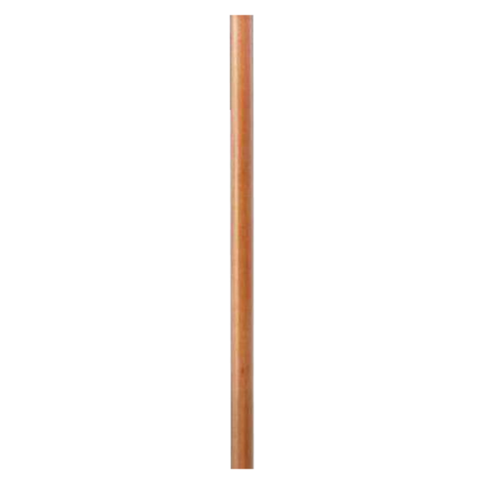
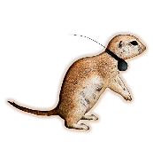

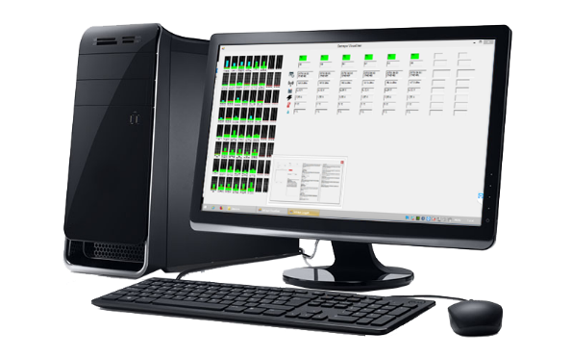
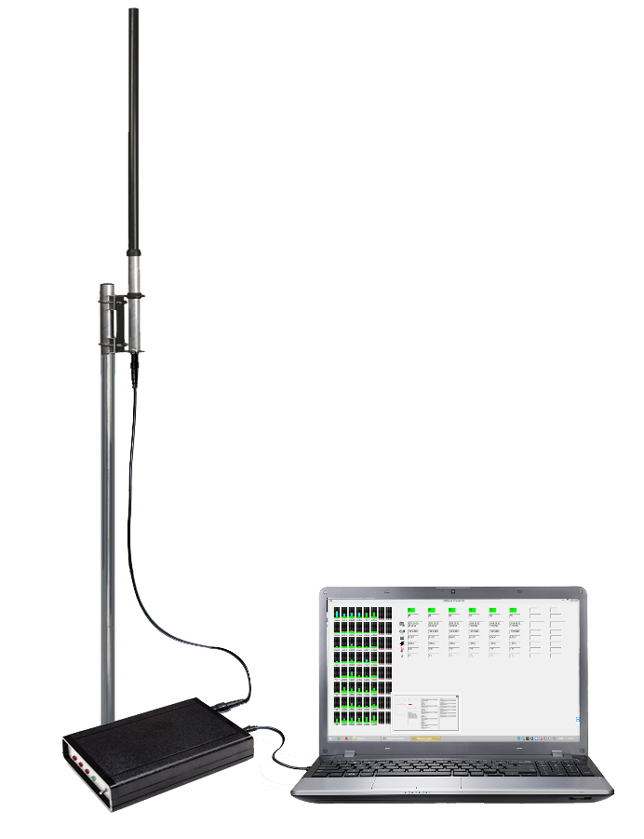

Slide 13
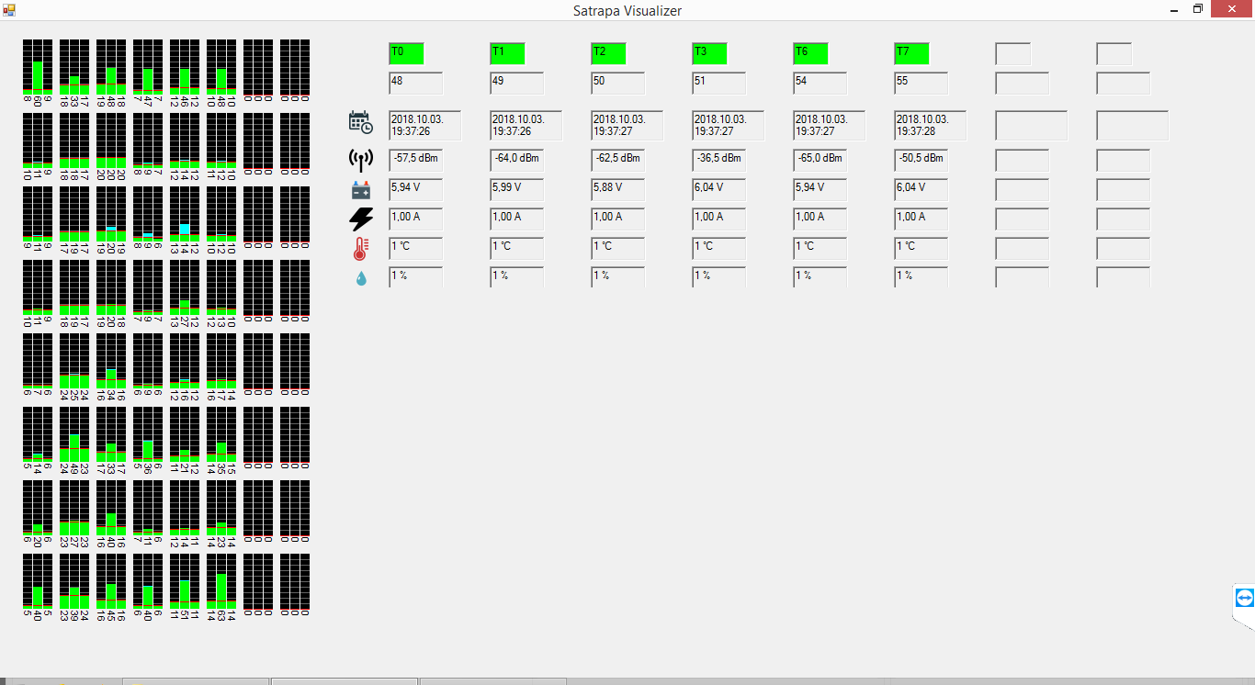
Data collection
Displays status informations, signal levels, fingerprinting patterns, position estimation etc. in real time

Slide 14
Data processing
To estimate home range, habitat and trajectories a physical model is needed. The model is based on the location of the receiver units and the environmental parameters (vegetation, topography, etc. )
This model establishes the connection between the geographical position of the transmitters and the signal strengths received by the receiver units
Two ways of estimation:
Position estimation based on physical models
Fingerprinting method with calibration on site:
Prior to, or
Following the measurements (backtracking)

Slide 15
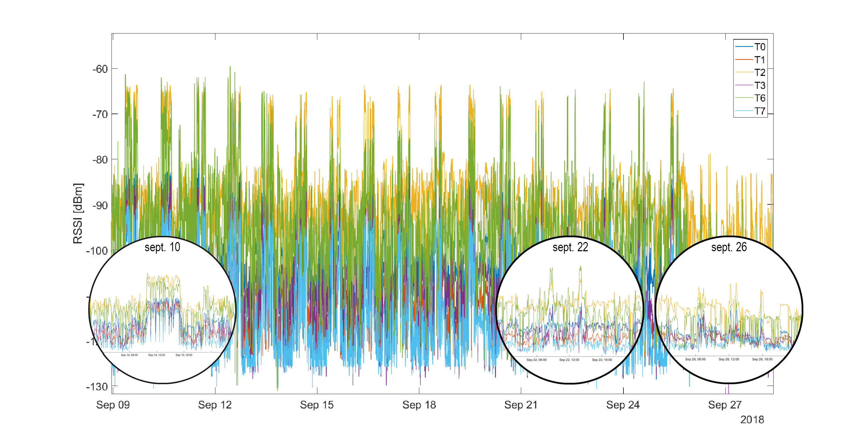
Data processing
Native time-dependent signals
From the analysis of the native time-dependent signals received by the receiver units we can draw conclusions about the status of the observed animals. (approximate location, behaviour, daily routine, etc.)

Slide 16
The last days of the observed small mammal before hibernation.

Slide 17
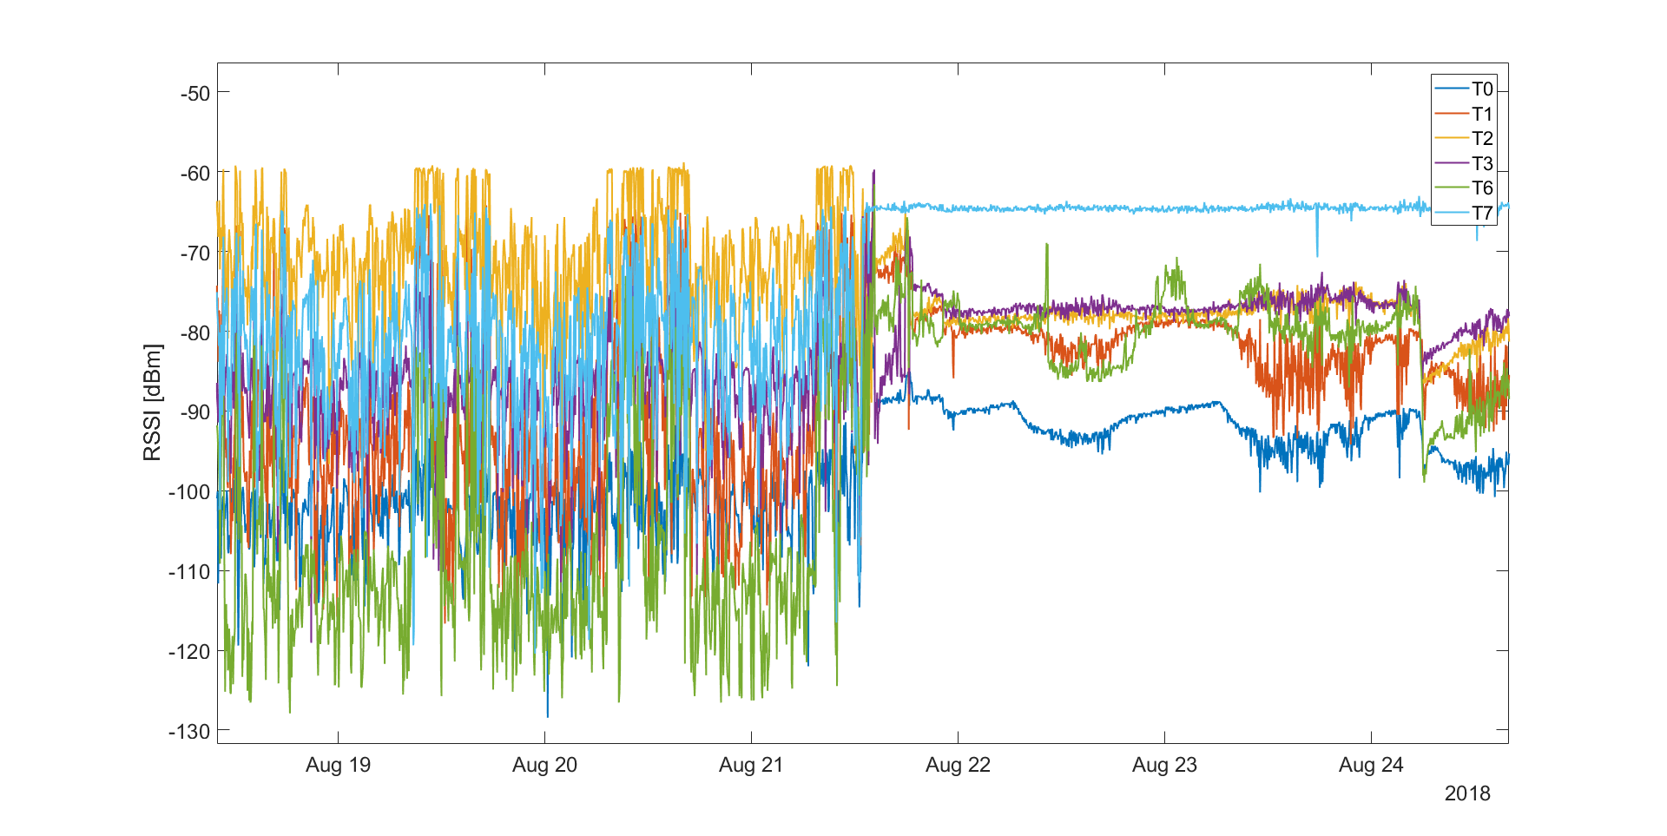
The death of a radio tagged animal caused by a predator.

Slide 18
Further data processing
Method is dependent on the main goal of the research.
Examples:
Monitoring activity depending on the changes of the environmental parameters (eg. Hunting, agricultural activity, construction works, etc.)
Trajectory definition of the observed animals
Habitat usage display in user defined timesteps.
Different habitat usage are characterized by different patterns. E.g.: An animal goes to drink from the spring each day at a certain time.
Structural analysis of habitat usage. Clusterisation of the movement pattern. t-SNE..
Ethological studies
Contact between the animals
Dynamics of tunnel-usage

Slide 19
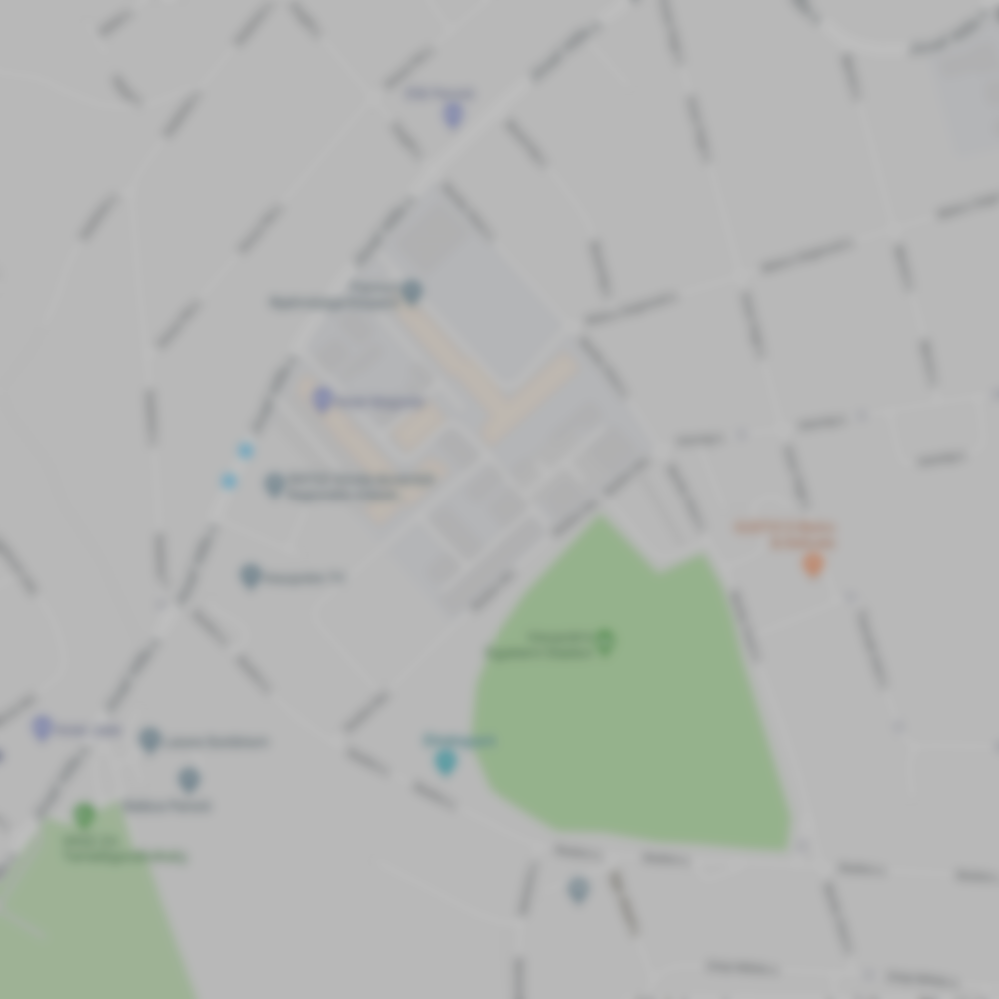
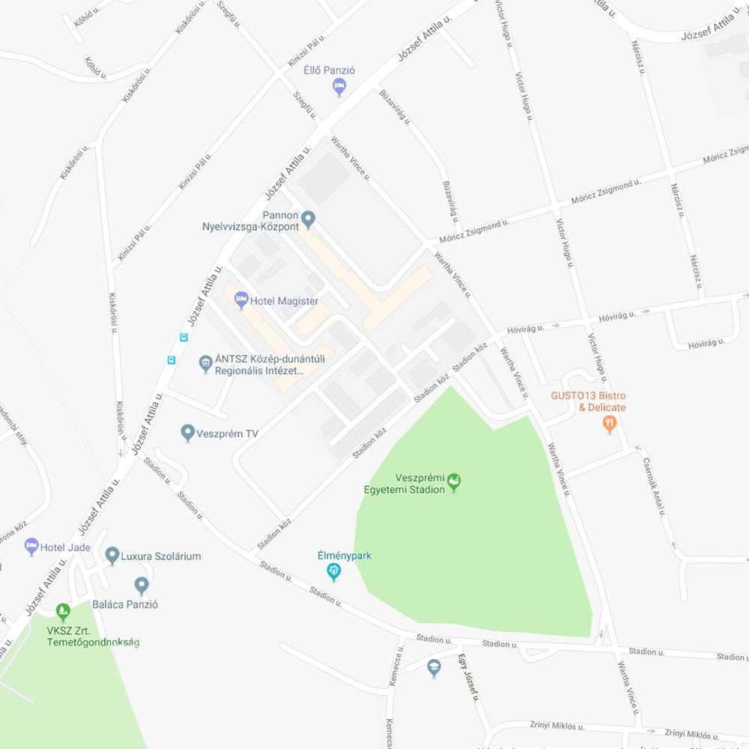


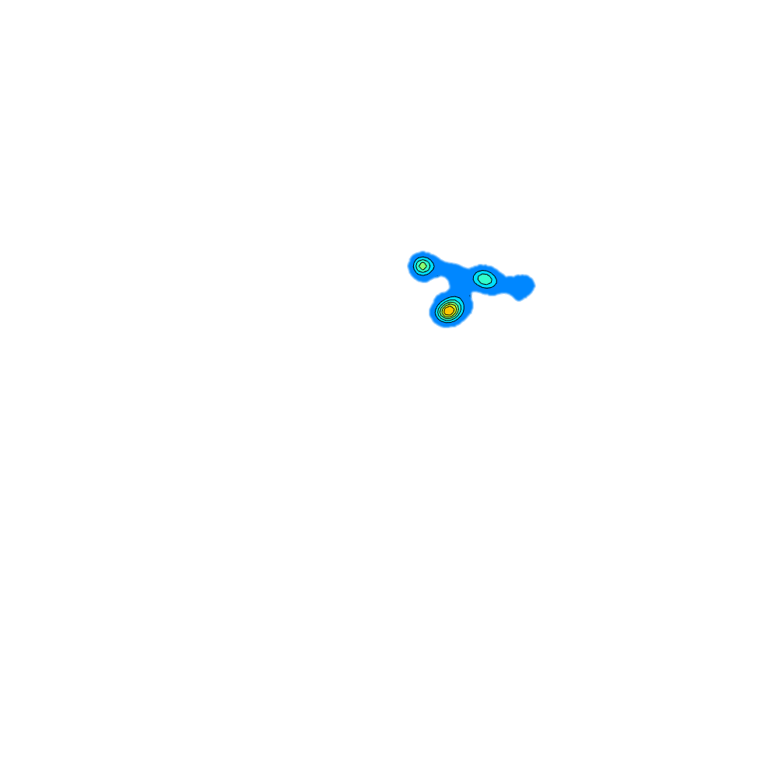
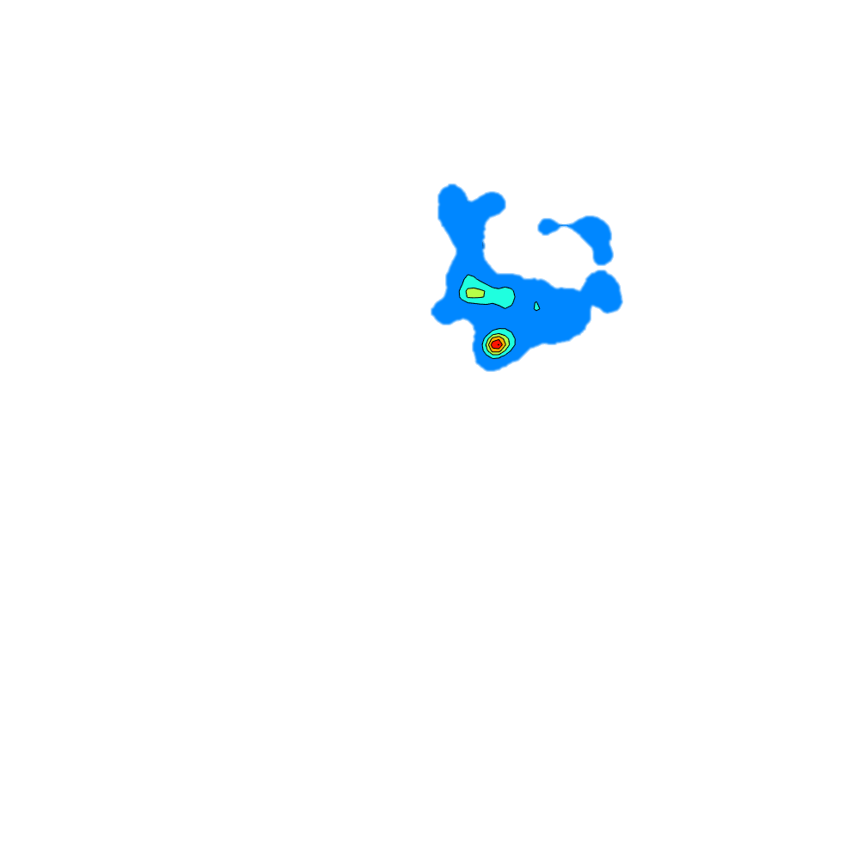

Area usage of a small bird after hatching period, during daytime.

Slide 20
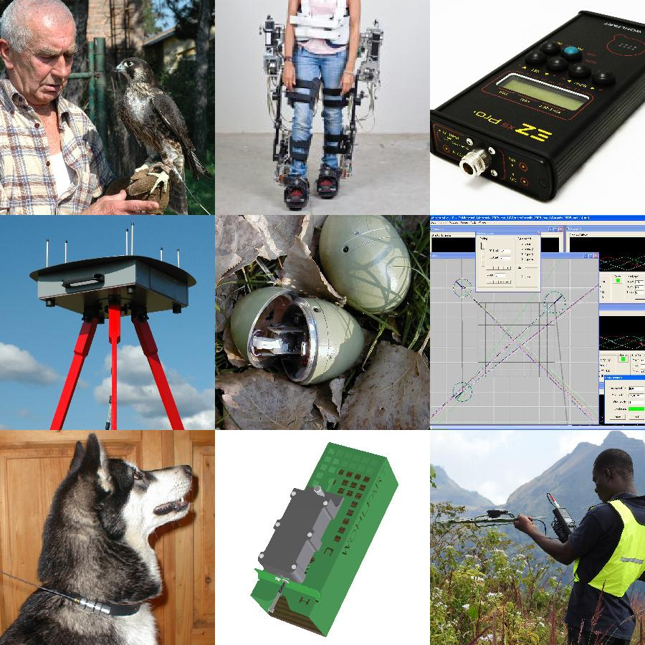
Our telemetry research group
A group of researchers from Budapest University of Technology and Economics and Eötvös Lorand University of Sciences formed for participating projects where biology, medical, biomechanics, or other disciplines and is involved.
Main fields of research and design:
Traditional, digital and fully automatized radiotracking system development
IT solutions: programming, mathematical algorithms, special purpose softwares, Internet of things (IoT), Internet of Animals (IoA)
Our Universities and our Enterprise are willing to collaborate in any kind of relevant projects.

Slide 21
Our Partners:
Natural History Museum Budapest - ARS, trap, insect needle counter
Pannon University – ARS, tit
University of Pécs – traditional and ARS, microtus oeconomus
Comenius University – ARS, microtus oeconomus
Szent István University – traditional and ARS, deer, rabbit
University of Sopron – ARS, rabbit
Fertő-Hanság National Park - bird rescue
ELTE Department of Ethology – dog, hedgehog
Urban Nature Research Group – hedgehog
BirdLife Hungary – traditional, falcon, eagle
Hungarian Academy of Sciences (MTA), Working Group of Monitoring and Watermanagemenet Experts for the Gabcikovo System of Locks – Szigetköz, habitat simulation
Revír Nonprofit Kft. – ground-squirrel

Slide 22
Thank you for your attention!
Contact info: Richard Wohlfart
Web: www.telemetry.hu E-mail: info@telemetry.hu
Tel: +36 20 443 7314

